Slide 1

Data Preprocessing
From Mess to Success

Slide 2
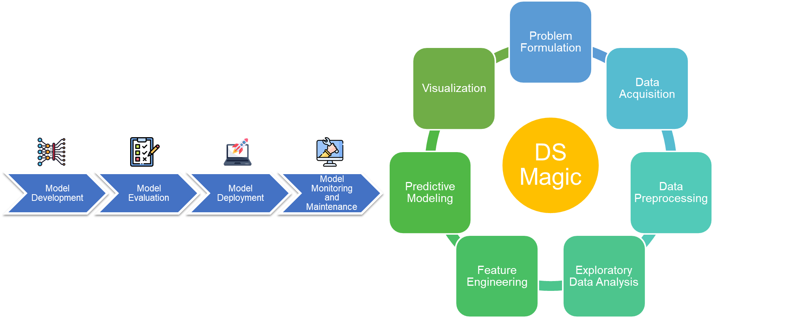
Recall
Identifying the Right Data
How can we make the data useful?

Slide 3
What is Data preprocessing?
Raw data -> Clean data
inconsistencies, errors, duplications, complexity
Cleansing
Reduction
Transformation
Enrichment
Validation
Quality Enhancement (produces accurate, complete, and consistent data)
Notes:
Data Preprocessing is an important step in the Data Science pipelines. There are various examples of when data preprocessing is necessary. For instance, data collected from different sources may have varying formats and structures, which need to be standardized before analysis. Incomplete or missing data can also be a problem that needs to be addressed through imputation techniques. Outliers and inconsistent data points can also be removed through data cleaning techniques to ensure accurate analysis.

Slide 4
Data Cleansing (1/8)
Identify and Correct: errors, inconsistencies, and inaccuracies.
Improve data quality for better analysis and modeling results.

Slide 5
Data Cleansing (2/8)
Missing values
Imputation
Replacement
Removal
Removing Redundancies
Correcting typos and data entry errors
Outlier detection & treatment
Removal
Transformed
Separated
Standardizing data formats and units.

Slide 6
Data Cleansing (3/6)
StudentID | Age | TestScore | Subject | Passed
101 | 17 | 85 | Math | Yes
102 | 16 | NA | Physics | No
103 | 17 | 78 | Math | Yes
104 | NA | 120 | Math | Yes
104 | NA | 120 | Math | Yes
105 | 15 | 66 | English | No
106 | 16 | -20 | Physics | No
107 | 18 | 91 | English | Yes
108 | 17 | 88 | Physics | Yes
109 | 19 | NA | English | Yes

Slide 7
Data Cleansing (4/6)
Missing Values
Imputation (Mean Imputation)
Mean Age Calculation (17 + 16 + 17 + 15 + 16 + 18 + 17 + 19) ÷ 8 = 16.875 ≈ 17
Mean TestScore Calculation (85 + 78 + 120 + 120 + 66 + (-20) + 91 + 88) ÷ 8 = 78.5 ≈ 79
ID | Age | TestScore | Subject | Passed
101 | 17 | 85 | Math | Yes
102 | 16 | 79 | Physics | No
103 | 17 | 78 | Math | Yes
104 | 17 | 120 | Math | Yes
104 | 17 | 120 | Math | Yes
105 | 15 | 66 | English | No
106 | 16 | -20 | Physics | No
107 | 18 | 91 | English | Yes
108 | 17 | 88 | Physics | Yes
109 | 19 | 79 | English | Yes

Slide 8
Data Cleansing (5/6)
Duplicate Values
Duplicates:
StudentID = 104
StudentID | Age | TestScore | Subject | Passed
101 | 17 | 85 | Math | Yes
102 | 16 | 79 | Physics | No
103 | 17 | 78 | Math | Yes
104 | 17 | 120 | Math | Yes
104 | 17 | 120 | Math | Yes
105 | 15 | 66 | English | No
106 | 16 | -20 | Physics | No
107 | 18 | 91 | English | Yes
108 | 17 | 88 | Physics | Yes
109 | 19 | 79 | English | Yes

Slide 9
Data Cleansing (5/6)
Duplicate Values
Duplicates:
StudentID = 104
StudentID | Age | TestScore | Subject | Passed
101 | 17 | 85 | Math | Yes
102 | 16 | 79 | Physics | No
103 | 17 | 78 | Math | Yes
104 | 17 | 120 | Math | Yes
104 | 17 | 120 | Math | Yes
105 | 15 | 66 | English | No
106 | 16 | -20 | Physics | No
107 | 18 | 91 | English | Yes
108 | 17 | 88 | Physics | Yes
109 | 19 | 79 | English | Yes

Slide 10
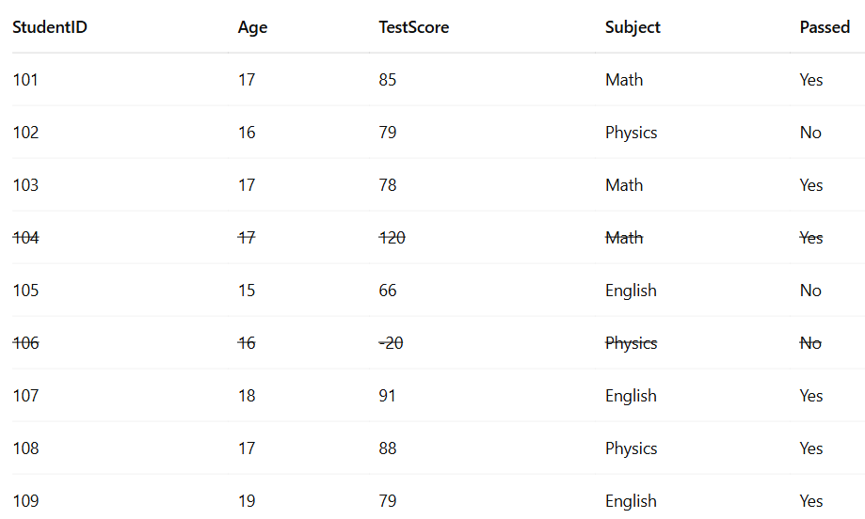
Data Cleansing (6/6)
Outliers
Outliers (TestScore):
Values 120, -20 are unrealistic scores.
Remove using a statistical (IQR) approach:

Slide 11
Data Reduction (1/4)
Reduce the dimensionality of the dataset while preserving important information.
Improve computational efficiency and reduce storage requirements.

Slide 12
Data Reduction (2/4)
Feature selection: Choose relevant features and eliminate irrelevant ones.
Principal Component Analysis (PCA): Create new, uncorrelated features to replace a set of correlated features.
Binning and discretization: Convert continuous variables into categorical ones to reduce complexity.

Slide 13
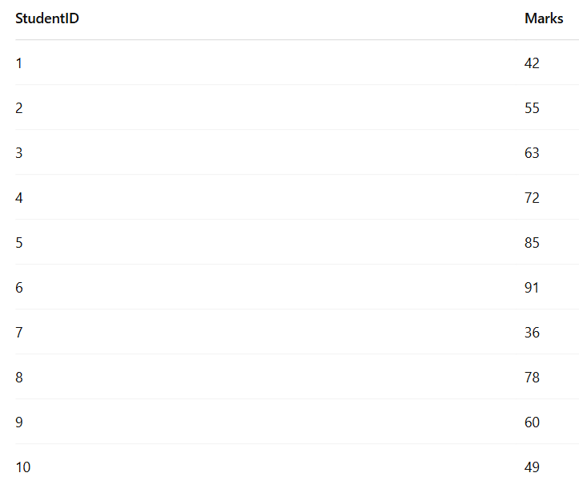
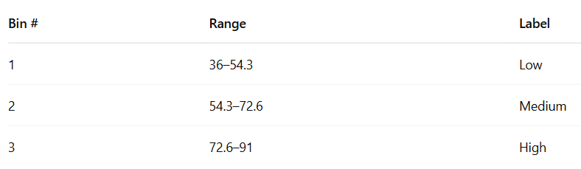
Data Reduction (3/4)
Used to convert continuous numerical values into categories or bins, often for:
Equal-Width Binning
Divide the range into equal-width intervals.
Range: max = 91, min = 36 → range = 55
If we choose 3 bins → width = 55 ÷ 3 = ~18.3

Slide 14
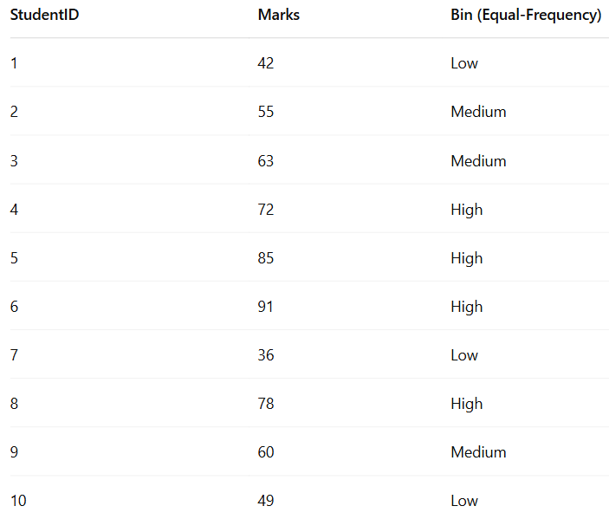
Data Reduction (4/4)

Slide 15
Mean = 63.1
Variance = (42-63.1)sqr+(55-63.1)sqr+(63-63.1)sqr…….+(49-63.1)sqr/10 = 301.09
Std =sqe root

Slide 16
Data Transformation (1/7)
Prepare the data for specific algorithms or modeling techniques.
Normalize or scale data to ensure features have similar scales.

Slide 17
Data Transformation (2/7)
Text normalization
Lemmatization
Stemming
Feature Scaling numerical data
Min-Max scaling
Z-score normalization
Logarithmic or power transformations
One-hot encoding: Convert categorical variables into binary (dummy) variables.
Aggregation: Combine data at a higher granularity level (e.g., daily to monthly).

Slide 18
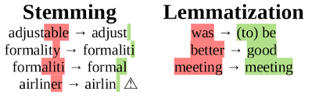
Data Transformation (3/7) Text normalization
Stemming
Lemmatization
stems or removes last few characters from a word
often leading to incorrect meanings and spelling.
stemming the word ‘Caring‘ would return ‘Car‘.
computationally inexpensive
considers the context and converts the word to its meaningful base form
Caring is correctly lemmatized to care
computationally intensive

Slide 19
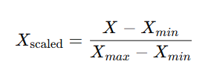

Data Transformation(4/7) Feature Scaling numerical data
Standardize or normalize the scale of numerical features
Here, the scaled features become new features.
Techniques:
Min-Max scaling
Z-score normalization
robust scaling
log transformation

Slide 20
Data Transformation (5/7) One-hot encoding
Many algorithms can only handle numeric features, so we need to encode the categorical ones.
Logistic Regression, KNN, Decision Trees, SVM, and many more
Simply adds a new 0/1 feature for every category, having 1 if the sample has that category.
Can explode if a feature has lots of values, causing issues with high dimensionality.

Slide 21
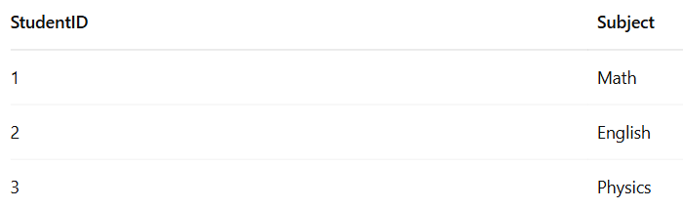
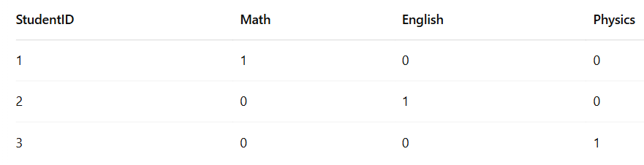
Data Transformation (6/7) One-hot encoding
Data:
After one-hot encoding

Slide 22
Data Preprocessing for Machine Learning
By cleaning, normalizing, and wrangling data, we can ensure that our models are working with accurate and complete data.
For example, if we have missing values in our dataset, it can lead to biased or incorrect results.
By imputing these missing values, we can improve the completeness of our data and therefore the accuracy of our models.
Similarly, Feature Scaling
can help algorithms converge faster
improves model accuracy
For example, if we have a dataset with features that have vastly different scales, such as age and income, scaling these features can ensure that neither has an undue influence on the model's predictions.

Slide 23
Data Preprocessing Checklist
Check for missing values and outliers in the data.
Clean the data by removing or correcting any errors, inconsistencies, or duplicates.
Normalize the data to ensure consistency in scale and range.
Tag the data to categorize and label it for analysis.
Wrangle the data by transforming, merging, or reshaping it as needed.
Impute missing data using appropriate techniques.
Reduce the data by selecting relevant features or variables.
Scale the data to ensure equal importance of all features.
Extract features from the data to improve model performance.

Slide 24
Real-World Examples
In a study conducted by researchers at Duke University, data preprocessing techniques such as data cleaning and normalization were used to analyze electronic health records (EHRs) for patients with heart disease.
By preprocessing the data, the researchers were able to identify patterns and risk factors that could be used to improve patient outcomes.
In a study conducted by researchers at the University of Maryland, data preprocessing techniques such as feature extraction and scaling were used to analyze stock prices and predict market trends.
By preprocessing the data, the researchers were able to develop more accurate models and make better investment decisions.

Slide 25
Thank you!

Slide 26
References
Han, J., Kamber, M., & Pei, J. (2011). Data mining: concepts and techniques. Morgan Kaufmann Publishers.
García, S., Luengo, J., & Herrera, F. (2015). Data preprocessing in data mining. Springer.
Abadi, D., Chu, A., Goodfellow, I., McMahan, H. B., Mironov, I., Talwar, K., & Zhang, L. (2016). Deep learning with differential privacy. In Proceedings of the 2016 ACM SIGSAC Conference on Computer and Communications Security (pp. 308-318).
Bellazzi, R., & Zupan, B. (2008). Predictive data mining in clinical medicine: current issues and guidelines. International journal of medical informatics, 77(2), 81-97.
Brownlee, J. (2020). How to Prepare Data For Machine Learning. Machine Learning Mastery. https://machinelearningmastery.com/how-to-prepare-data-for-machine-learning/

